Slide 1


Meet & Merit
Gamifying Academic Success & Real-World Connection
Name: Shuai Jiang Student Number: C00292846

Slide 2

Project Overview: From Pain Points to Solutions
The Problem (User Persona: "Steve")
•
Overwhelmed: Struggles to manage heavy academic workloads.
•
No Motivation: Hard to maintain focus on long-term goals.
•
Social Isolation: Feels disconnected from peers.
The Solution
•
Hybrid Platform: Productivity tools meets RPG gameplay.
•
Core Differentiator: "Offline First" social interaction powered by Bluetooth (BLE).

Slide 3
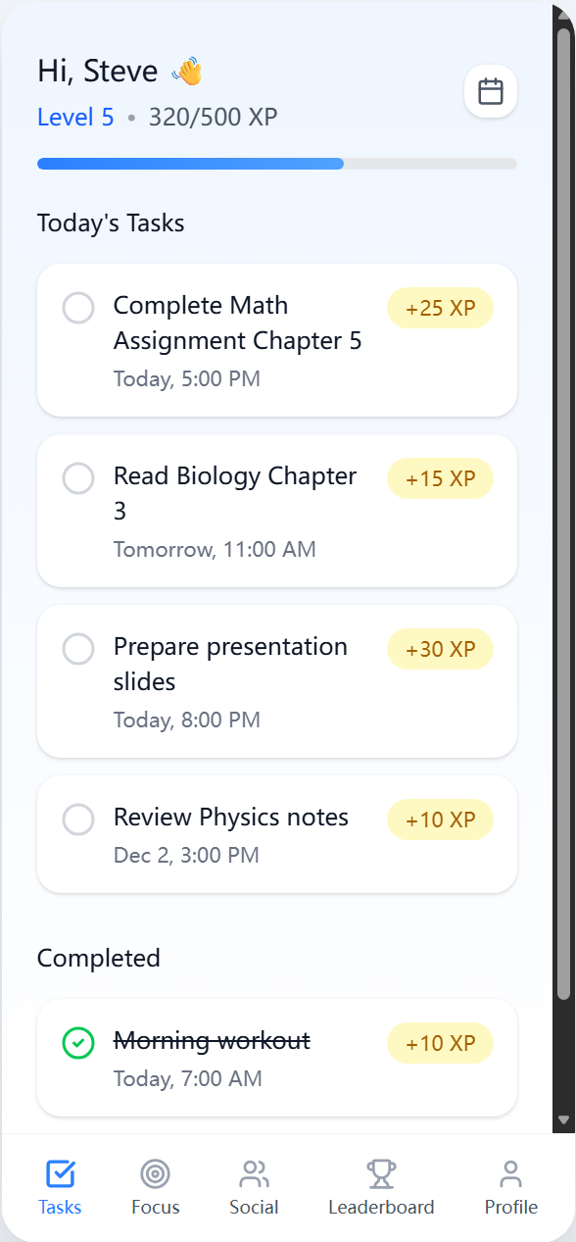
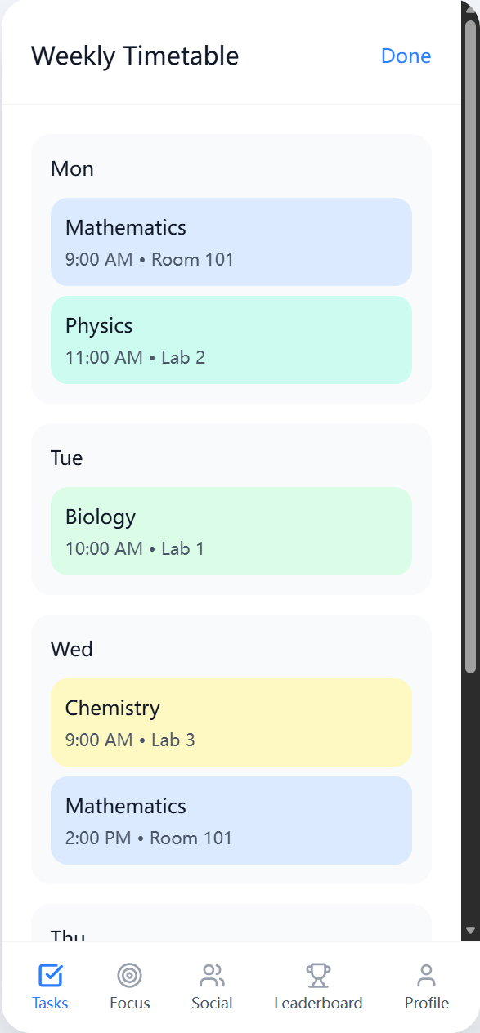
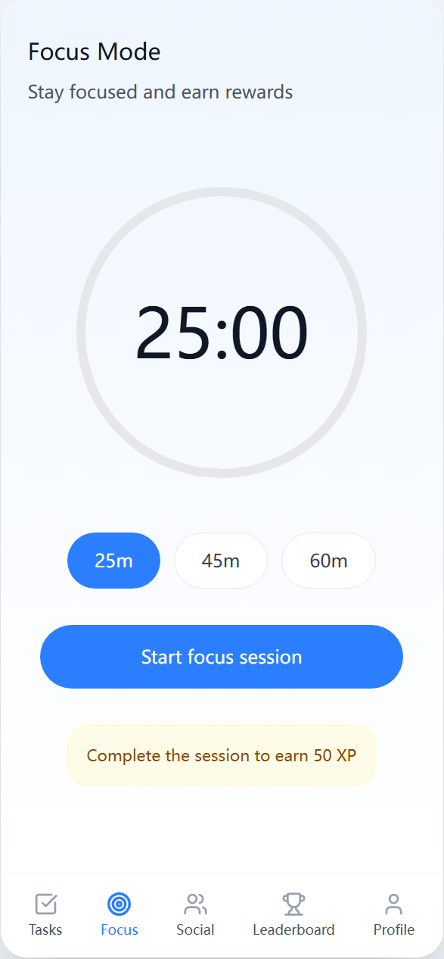
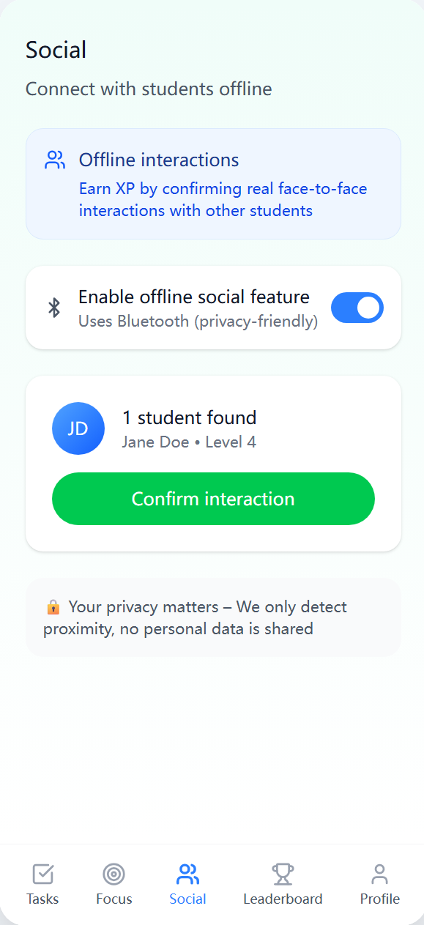
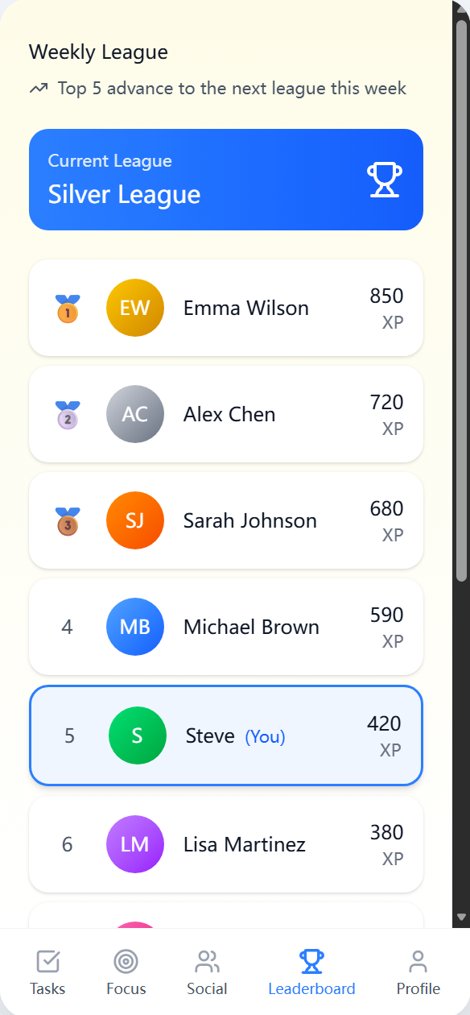
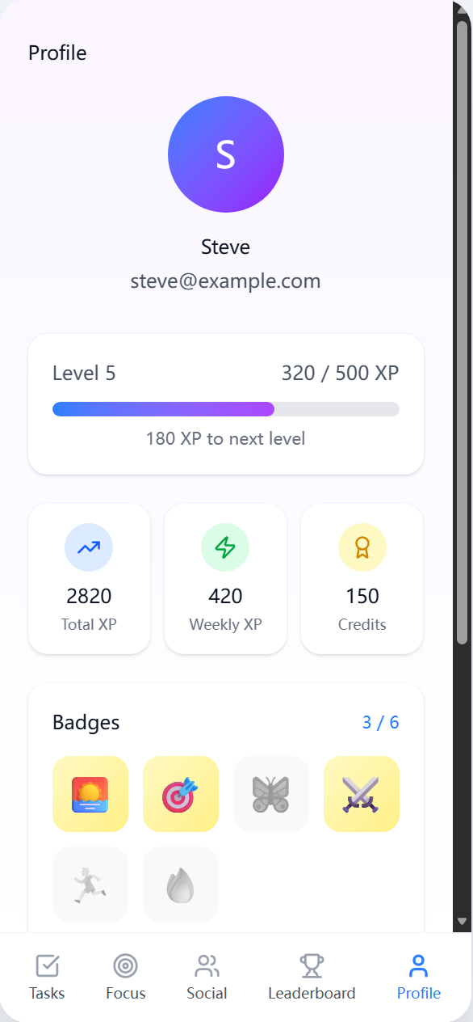
Core Functionality
Target UI Concept ➝
Productivity Suite Task Management, Weekly Timetable, and Focus Mode (Timer).
Gamification Engine XP & Leveling System, Achievement Badges, and Global Leaderboards.
Social Innovation (Offline) BLE Technology scans for nearby devices. Requires face-to-face confirmation to earn social rewards.

Slide 4






Technical Architecture
Frontend (Android Studio)
Backend (Visual Studio Code)
Native Android Development (Kotlin)
RESTful API built with Django (Python)
Database Evolution
Deployment
Dev: SQLite (Rapid Prototyping) Prod: PostgreSQL (ACID Compliance)
Heroku Cloud Platform

Slide 5
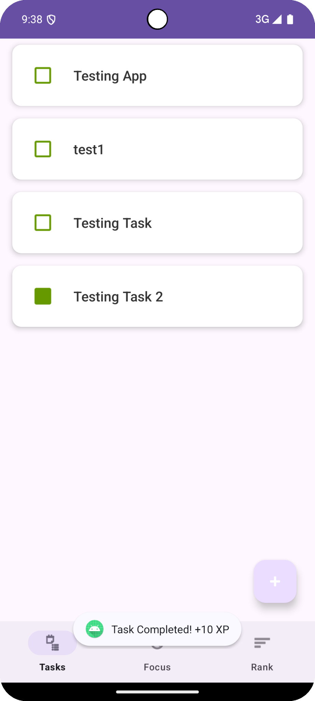
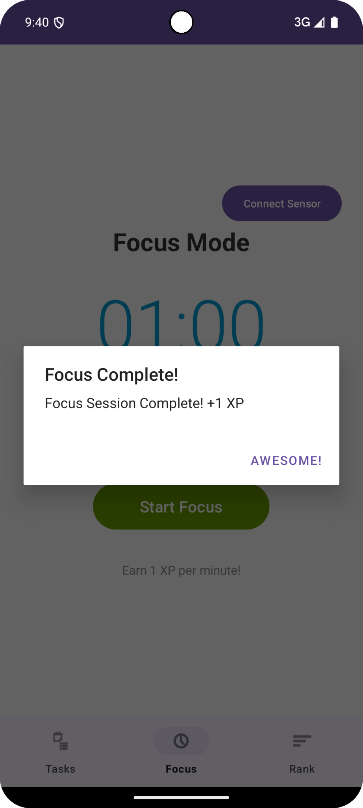
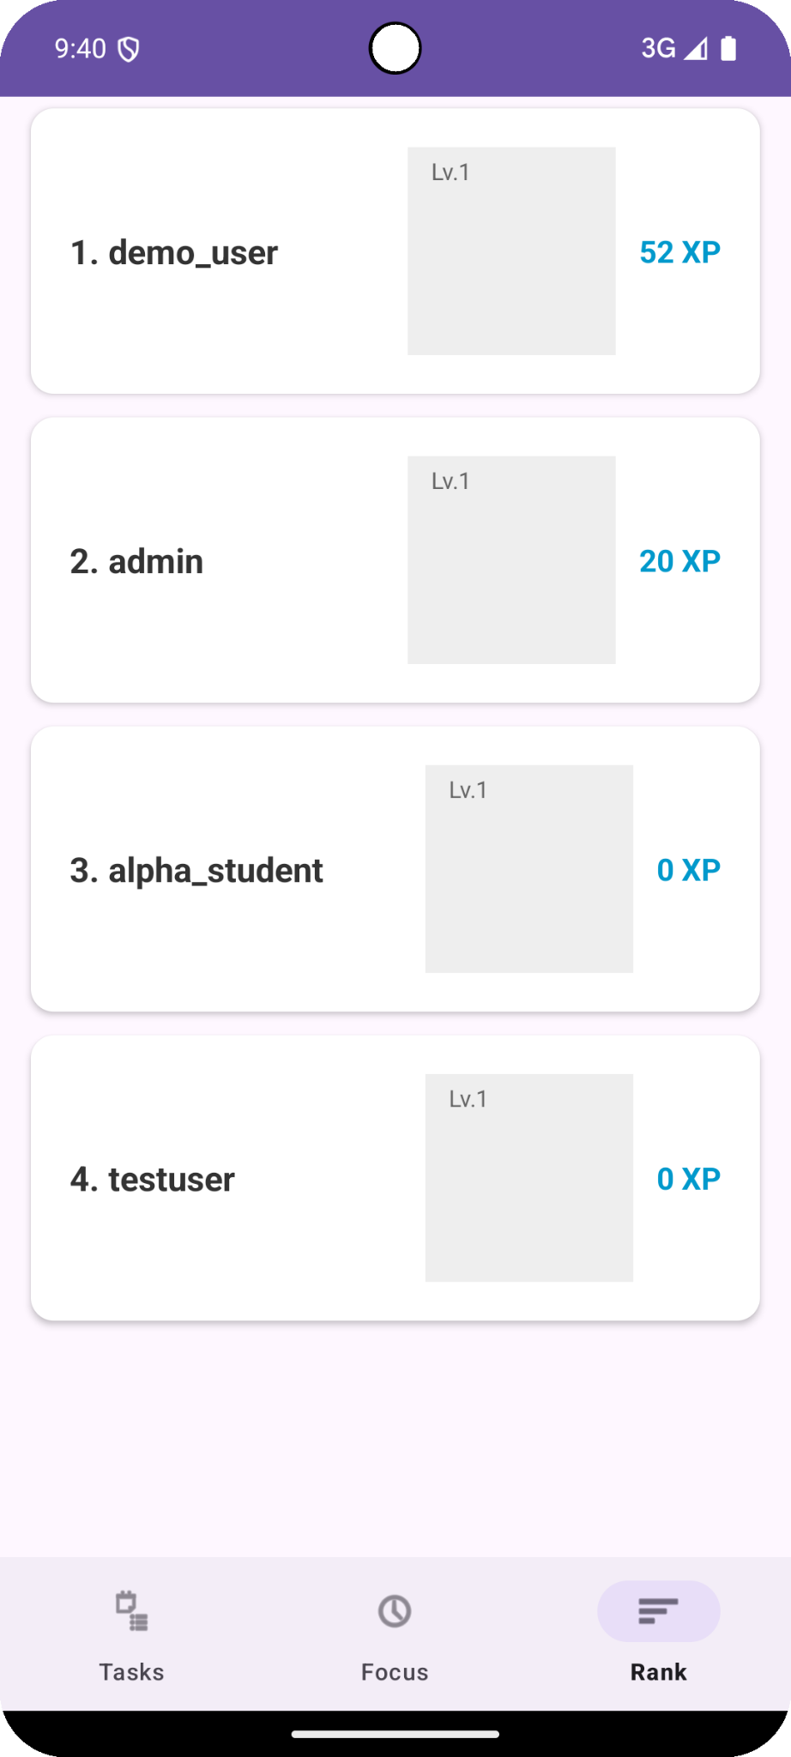
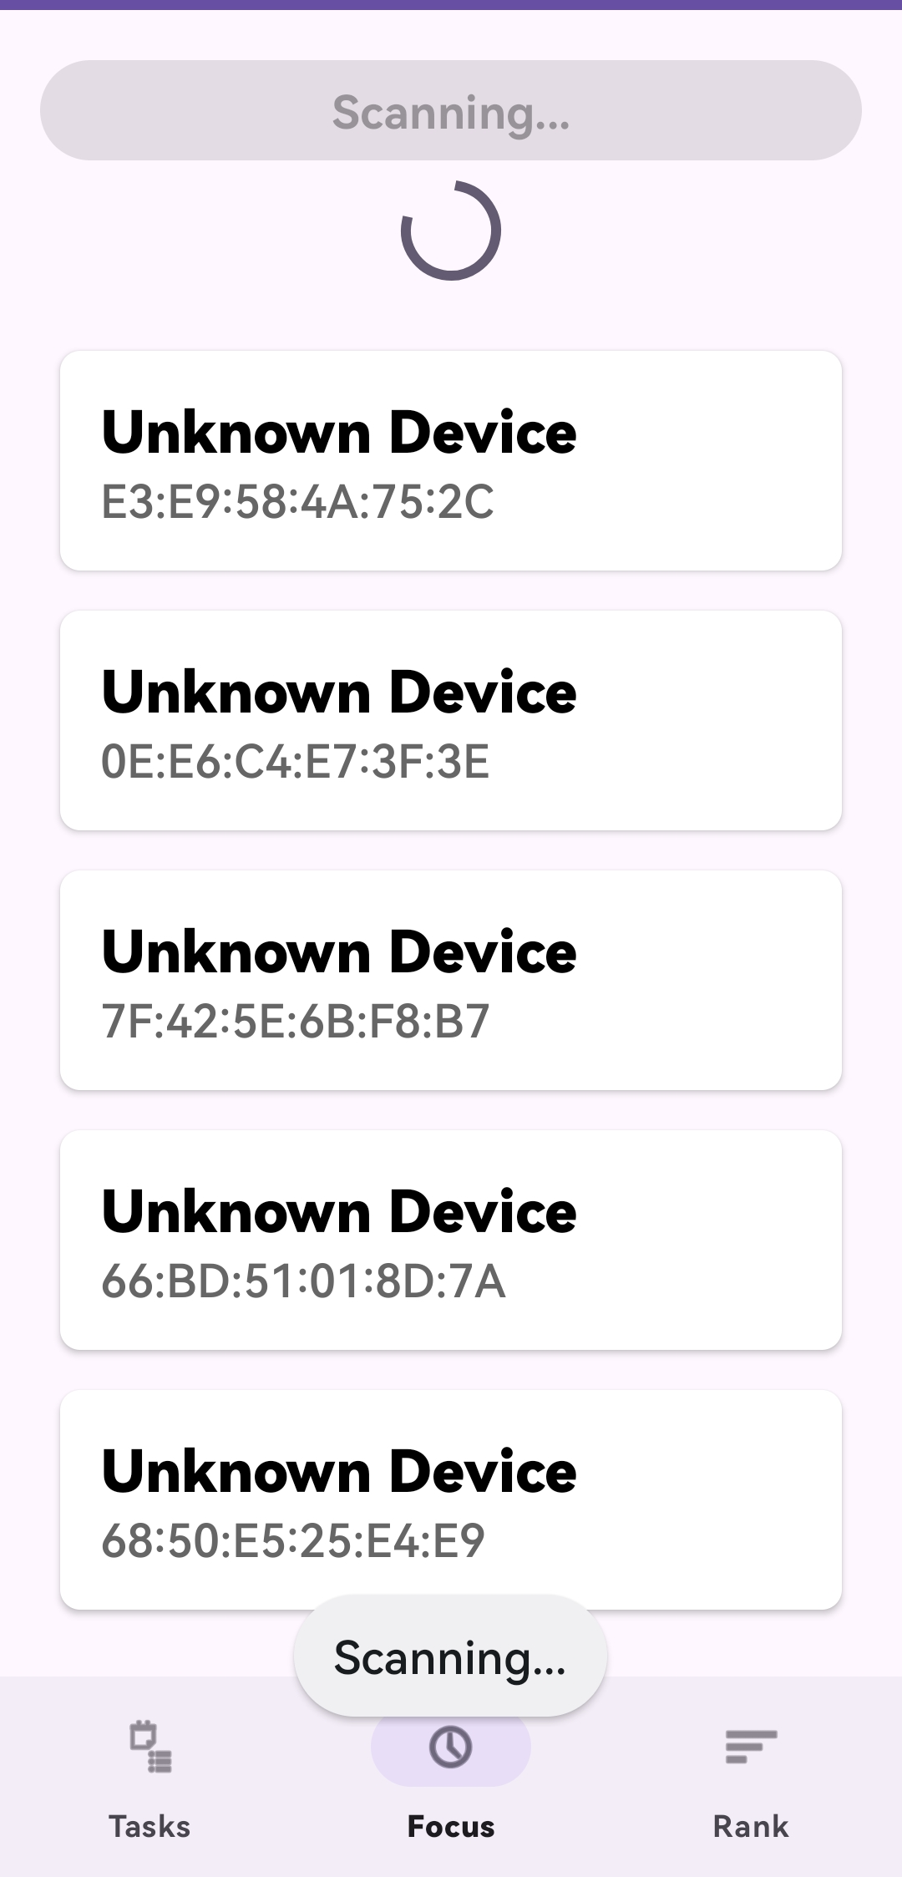
Current Progress (Iterations 1 & 2)
Documentation Completed Research & Functional Specification and Design Document (Draft).
Backend Infrastructure Django project initialized. Auth & Task Management APIs operational.
Frontend Development User Registration/Login UI & Functional To-Do List interface.
Technical Proof of Concept BLE Scanning logic implemented to successfully detect Movesense devices.

Slide 6


Future Roadmap & Challenges
Left to Do (Next Steps)
Issues for Discussion
•
Timetable: Full implementation of weekly schedule.
•
Bluetooth Security (Key Technical Challenge): Designing a handshake protocol to prevent "point farming" without real interaction.
•
Virtual Shop: System to exchange XP for virtual items.
•
Hardware Connectivity: Optimizing connection stability vs. battery drain with Movesense.
•
UI/UX: Full migration to Material Design 3 standards.

Slide 7
Q&A
Any Questions?

